Slide 1
Electronic Visit Verification: Information Sharing and Advisory Council (ISAC) Update Jeremy Yale ODP, Bureau of Policy and Quality Management February 25, 2019 11:30am-12:30pm

Slide 2
What is Electronic Visit Verification?
The 21st Century Cures Act requires states to develop Electronic Visit Verification (EVV) systems in an effort to increase accountability in the delivery of Medicaid funded services.
States that do not comply with the Cures Act will have their Federal Medical Assistance Percentage (FMAP) reduced.

Slide 3
EVV Devices
Services may be verified by:
The recipient’s home landline telephone (Telephony)
Smart phone,
Biometric recognition systems,
Or fixed visit verification device- an electronic random numbers device in the beneficiary’s home.

Slide 4
Required Information to be Collected
Type of service provided
Individual receiving the service
Individual providing the service
Date of the service
Location of the service deliver
Time the service begins and ends

Slide 5
EVV in Pennsylvania
Pennsylvania selected to implement an OPEN
EVV system, which means that:
Providers with an existing EVV system may continue to use their system as long as that system can send information to the state system. The state run system will receive information from the non-state system.
Providers without an existing EVV system can use the state-provided EVV system.

Slide 6
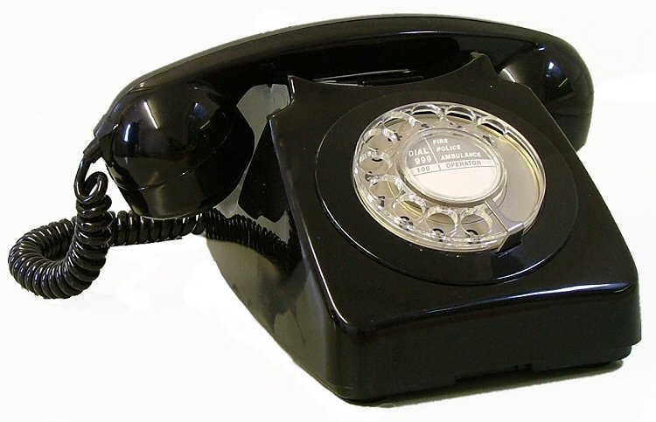
How does EVV work?

Slide 7
Impacted DHS Programs
EVV will be required for personal care and home health care services provided in the following Medical Assistance programs:
Adult Autism Waiver Program
Aging Waiver Program
Attendant Care Waiver Program
Community HealthChoices Program
Community Living Waiver Program
Consolidated Waiver Program
Fee-For-Service
HealthChoices Program - Physical and Behavioral Health
Independence Waiver Program
OBRA Waiver Program
Person/Family Directed Support Waiver Program

Slide 8
Personal Care Services (PCS)
Medicaid covers PCS for eligible individuals through Medicaid State Plan options and/or through Medicaid waiver and demonstration authorities approved by CMS
Consists of services supporting Activities of Daily Living (ADL), such as movement, bathing, dressing, toileting, transferring, and personal hygiene
Offers support for Instrumental Activities of Daily Living (IADL), such as meal preparation, money management, shopping, and telephone use

Slide 9
What services are under PCS?
OLTL Waivers
(Includes Agency and Participant-Directed Services)
Personal Assistance Services
Respite (unlicensed settings only)
ID/A Waivers
(Includes Agency and Participant-Directed Services)
Companion
In-Home and Community Support
Respite (unlicensed settings only, camp)
Homemaker/Chore (chore portion not included)
AAW
Community Support
Respite (unlicensed settings only)

Slide 10
Important Dates
April 2019 – Technical specifications to be distributed.
July 2019 – Provider training to be offered with phased in system use. Training will continue to be offered through full implementation.
September 2019 – Soft launch of DHS EVV system.
January 1, 2020 – All state Personal care services (PCS) comply with CMS EVV requirements
January 1, 2023 – All state Home health care (HHC) services comply with CMS EVV requirements

Slide 11
Discussion

